Slide 1
Student Finance
2025
Sally Armstrong

Slide 2
Session Content
Student Finance Package
Repayment
How to apply
Questions

Slide 3
Qualifying
There are three main conditions
a student has to meet:
They must be personally eligible
The course must be eligible
The university or college must also be eligible

Slide 4
What student finance is available?
Tuition Fee Loan
Maintenance Loan
University Bursaries and Scholarships
Extra support for special circumstances

Slide 5
Tuition Fee Loan
Tuition fee level of up to £9,535 per year
Available to all eligible students
Not based on household income
Paid by Student Finance England direct to university
Repayable when the student finishes or leaves the course and students must
Apply every year

Slide 6
What is Household Income?
Student’s income
Parents’ income
Deductions –
certain pension payments
£1130 for each dependent child
Changes in income

Slide 7
Maintenance Loan
Entitlement depends on:
Household income
proportion not dependent on household income
proportion dependent on household income
Where you live while you are studying
Year of course
Repayable when the student finishes or leaves the course and students must
Apply every year.

Slide 8
 | All eligible students can apply for this | Depending on household income you could also get up to | Max. Loan
Studying outside of London and not living with parents | £4,915 | £5,629 | £10,544
Studying in London and not living with parents | £6,853 | £6,909 | £13,762
Living in parents’ home | £3,907 | £4,970 | £8,877
Overseas | £5,838 | £6,238 | £12,076

Slide 9
What will your son or daughter be able to borrow?
Students with household incomes of £25000 or less receive maximum loan
Students with household incomes above this have their loans reduced.
Outside London - £1 for every £6.64 above £25000
London - £1 for every £6.53 above £25000
Home - £1 for every £6.71 above £25000

Slide 10
Example:
Household income of £55000.
Student outside London (max loan £10544)
£55000 less £25000 = £30000.
Divide by £6.64 = £4518 reduction
Maximum loan = £10544 less £4518
= £6026 receivable.

Slide 11
What will parents have to pay?
Household income up to £42875 – none
Household income of more – assessed contribution
Example: Household income of £55000
Student studying outside London
Contribution disregard (amount between 25000 and 42875)
£42875-£25000 = £17875 / £6.64 = £2692
Previous calculation = £4518 (the reduction) less £2692
= £1826 parental contribution
Student could receive £6026 + £1826= £7852

Slide 12
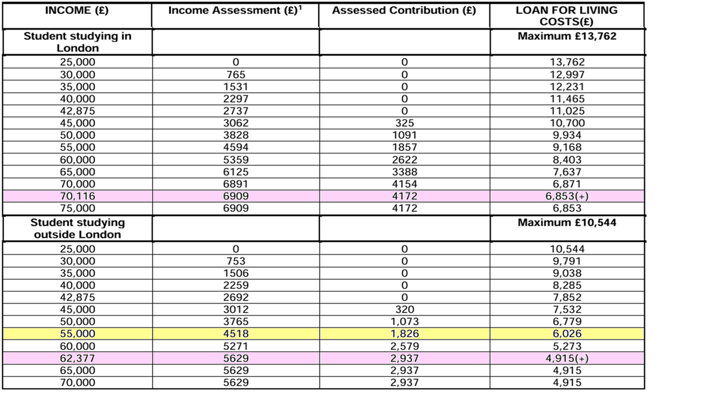
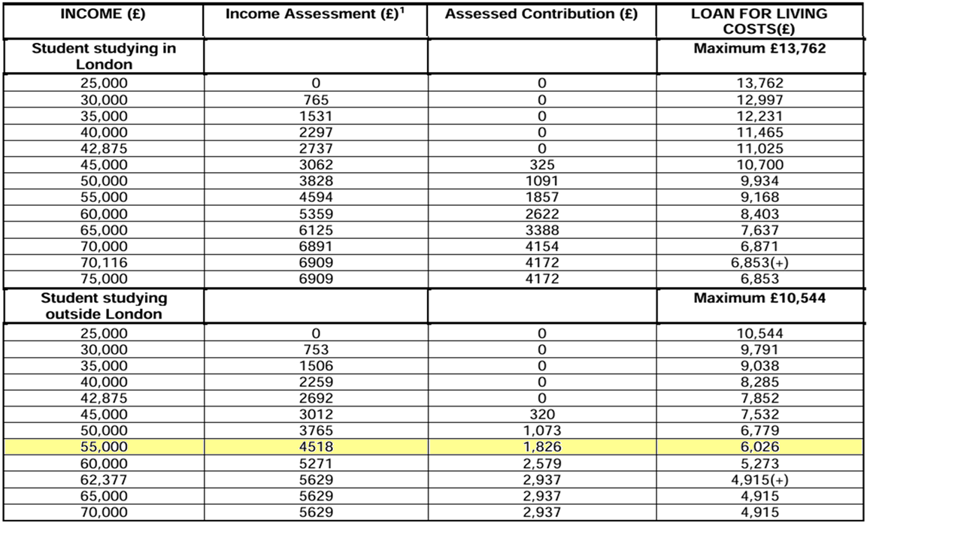
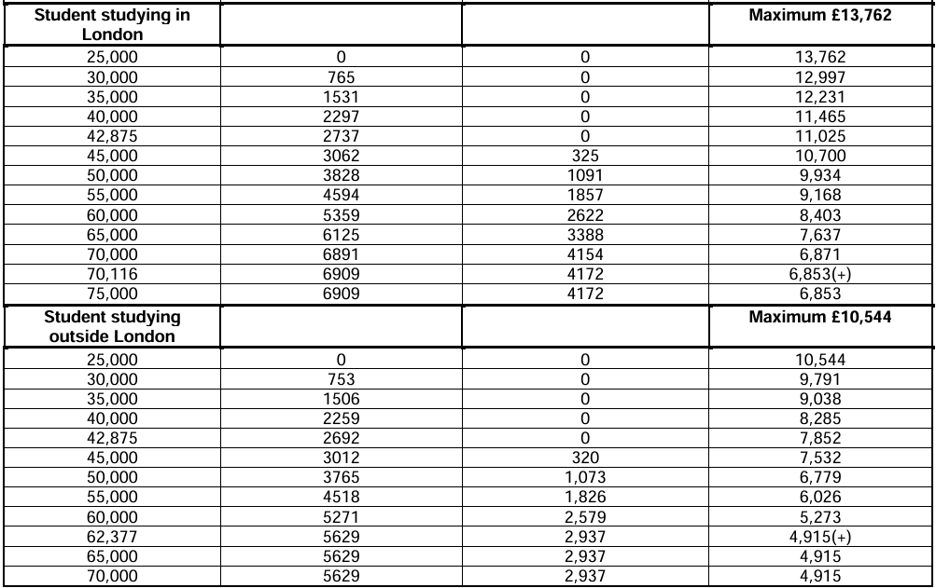

Slide 13
Other Support
Bursaries and scholarships
NHS Funding
Extra help for special circumstances, e.g. students with a disability
Support for part-time courses.

Slide 14
Average student living costs
Rent £439
Groceries £133
Household bills £79
Going out £69
Transport £69
Takeaways and eating out £66
Clothes and shopping £48
Holidays and events £36
Health and wellbeing £26
Other £25
Mobile phone £24
Course materials £24
Gifts and charity £21
Friends and family £19
TOTAL £1,078
Notes:
Save the Student Money survey

Slide 15
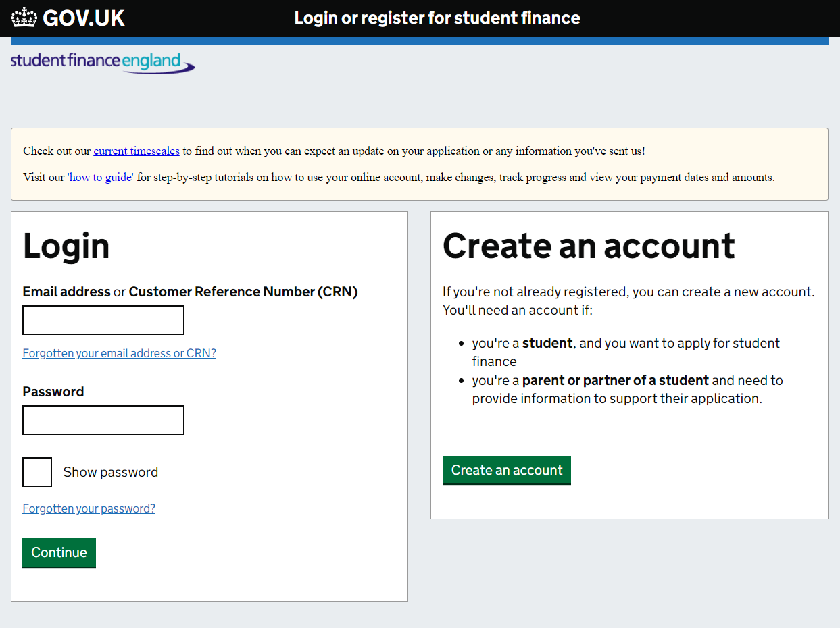

Slide 16
Repaying the Loans
Paid on earnings over £25,000
9% of income over threshold
Deducted from salary through the tax system
Any outstanding balance written off by government after 40 years
Interest RPI

Slide 17
Annual income before tax | Monthly salary | Monthly repayment
Up to £25,000 | £2,083 | £0
£28,000 | £2,333 | £22
£29,500 | £2,458 | £33
£31,000 | £2,583 | £45
£33,000 | £2,750 | £60

Slide 20
Resources
thescholarshiphub.org.uk
moneysavingexpert.com/students
gov.uk/student-finance
thestudentroom.co.uk/student-finance

Slide 21
Thank you
Q and A

